Slide 1
Introduction to pytest
- simple, powerful, extendable test framework for python
Dongwei Hong(Wayne)

Slide 2
Topics
Why pytest
Features
assert
mark
fixture
reporting
Plugins
Further reading

Slide 3
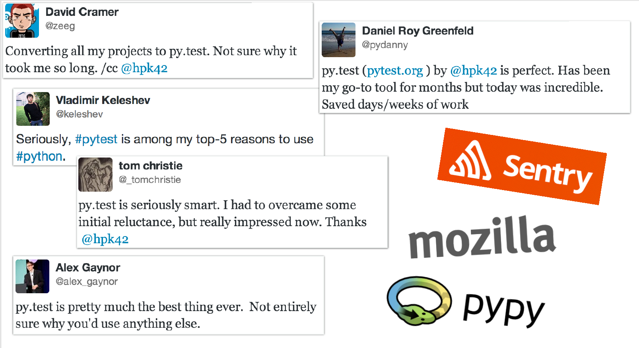
Used by organizations

Slide 4
A demo
test using unittest(more java style)
test with pytest test_unittest(more pythonic way)

Slide 5
pytest make life easier
Assertions with plain assert statement
Subclassing TestCase is not required
Tests are found and collected with pytest command automatically.

Slide 6
pytest features
Detailed info on failing assert statements (no need to remember self.assert* names);
Auto-discovery of test modules and functions;
Modular fixtures for managing small or parametrized long-lived test resources;
Can run unittest (including trial) and nose test suites out of the box;
Python 2.7, Python 3.4+, PyPy 2.3, Jython 2.5 (untested);
Rich plugin architecture, with over 315+ external plugins and thriving community;

Slide 7
Assertion rewriting

Slide 8
mark
Marking test functions with attributes

Slide 9
fixture

Slide 10
Plugins

Slide 11
Resources
Demo project:
https://github.com/hdw868/pytest_demo
Further reading:
Python Testing with pytest(by Brian Okken)
Official document

